Slide 1
Case for priming, not checkpoint, in cancer immunotherapy of pancreas cancer
Robert H. Vonderheide, MD, DPhil
Director, Abramson Cancer Center at the University of Pennsylvania
Vice Dean, Cancer Programs, Perelman School of Medicine
Vice President, Cancer Programs, University of Pennsylvania Health System
6 May 2022

Slide 2
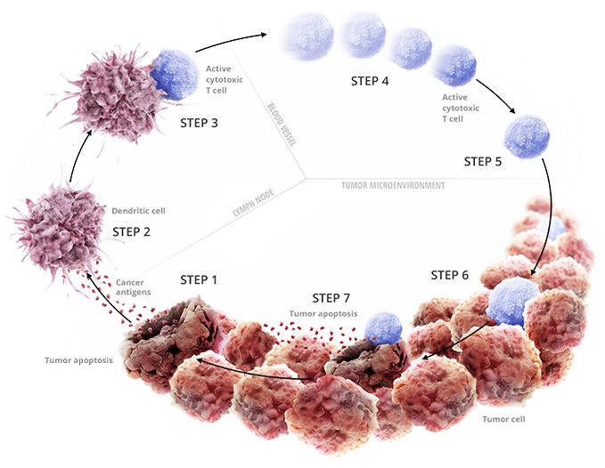
Cancer Immunity Life Cycle:
A case for priming, not checkpoint
Checkpoint blockade
DC activation
Neo-epitope rich
T cell infiltrated
Modified from Chen et al, Immunity, 2013

Slide 3
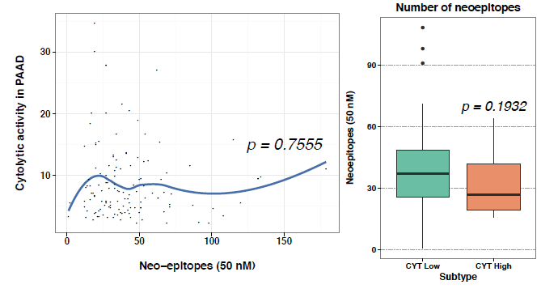
Pancreatic cancer: disconnect in neo-epitopes and T cells
N=134 PDA primary tumors from TCGA
Cytolytic Index
Neo-epitopes (50 nM)
CYT Low CYT High
Balli et al, Clin Can Res, 2017
Rech et al, Cancer Immunol Res, 2018
Richman et al, Cell Systems, 2019
Neoepitopes predicted by Antigen.Garnish, an ACC/Penn-developed R package on dbgap

Slide 4
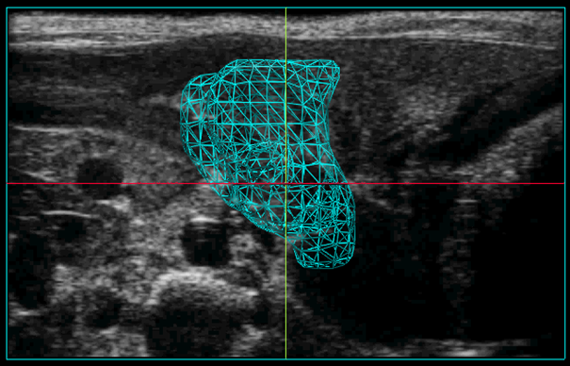
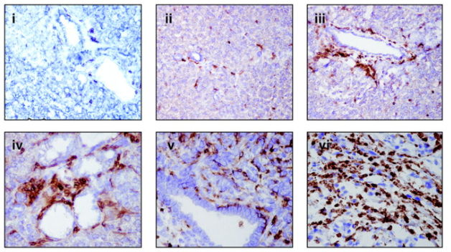
‘KPC’ genetically engineered mouse model of PDA
“KPC”
Progression from non-invasive
to invasive neoplasia in an
immune competent host
Kras^{G12D/+} Trp53^{R172H/+} Pdx-1 Cre
PDAC tumor on ultrasound
CD45 IHC
Clark et al, Can Res, 2007

Slide 5
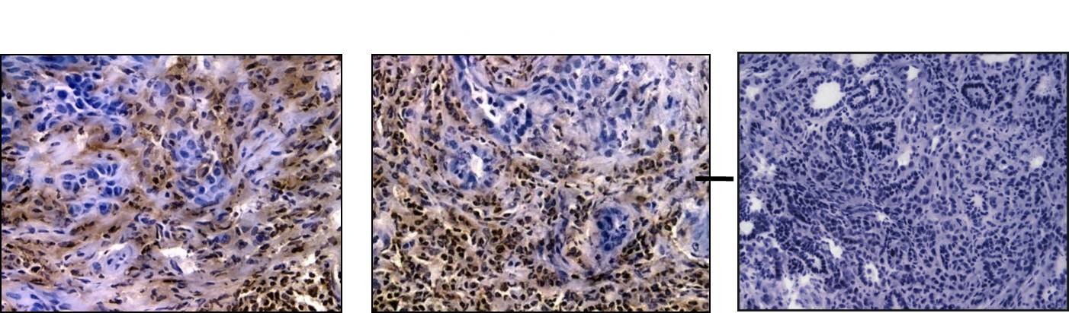
Spontaneous tumors in KPC mice: inflamed but T cell poor
If you examine the whole KPC tumor,
CD45
F4/80
CD3
Beatty et al, Science, 2011
Notes:
5

Slide 6
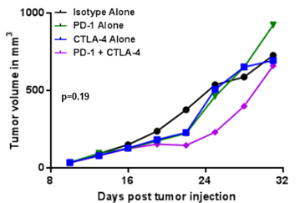
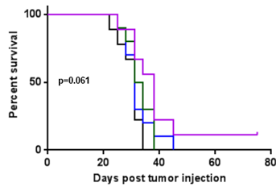
No efficacy of PD-1 or CTLA-4 in KPC mice
KPC mouse cell line s.c.
Same result in orthotopic tumors and spontaneous tumor bearing KPC mice
Consistent with experience in PDA patients treated with checkpoint blockade
Winograd et al, Can Immunol Res, 2015

Slide 7
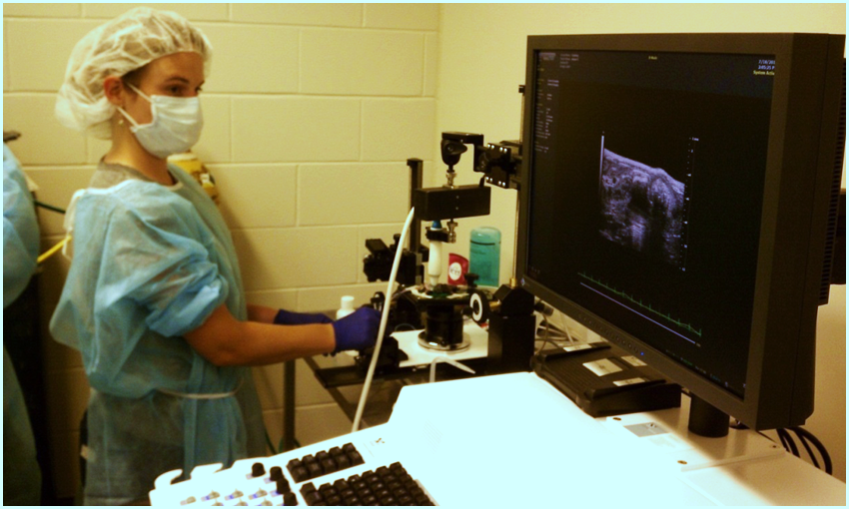
T cell immunosurveillance in KPC mice?
Young KPC
(<5 weeks)
Kras^{G12D/+} Trp53^{R172H/+} Pdx-1 Cre
Serial ultrasounds
Moribund or
tumor >1000mm³
CD8 (2.43) + CD4 (GK1.5)
IgG2b isotype control (LTF-2)
Endpoints:
Tumor burden (serial U/S)
Survival: age at sac

Slide 8
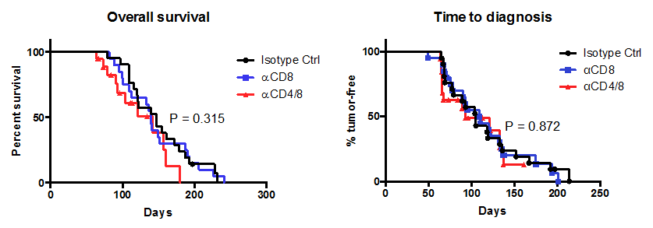
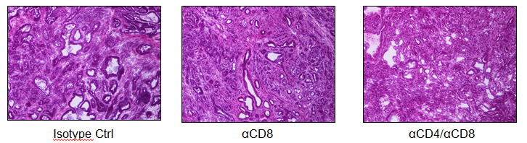
T cell immunosurveillance in KPC mice?
Median overall survival:
147 d isotype
139 d CD8 depleted
142 d CD4/8 depleted
P=0.25
N=20 mice per cohort
Evans et al, JCI Insight, 2016

Slide 9
Cardinal features of immunoediting
are not observed in the KPC model
Implication: If there has been no immunoediting
then PDAC tumor cells should be sensitive to T cells,
…but we have to generate T cells
Vonderheide, Cancer Cell, 2018

Slide 10
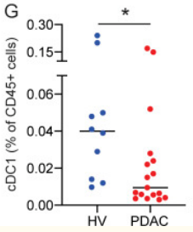
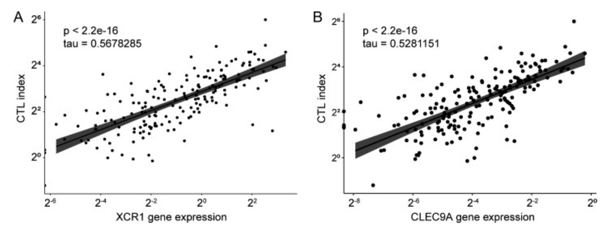
Conventional DC type 1 (cDC1) in humans with pancreatic cancer
Blood
Tumor
CD141+ cDC1 (% of CD45+ cells)
Lin et al, J. Exp. Med., 2020

Slide 11

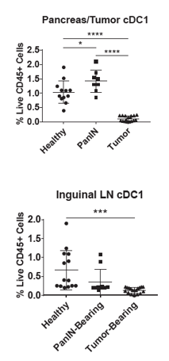
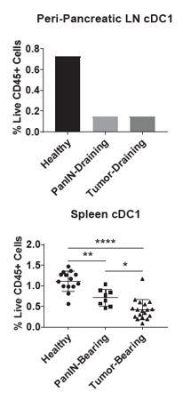
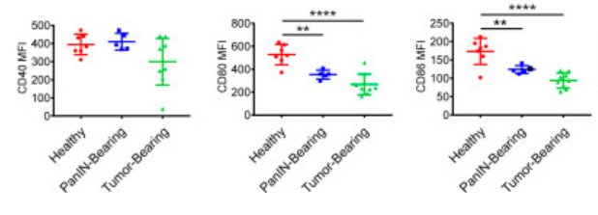
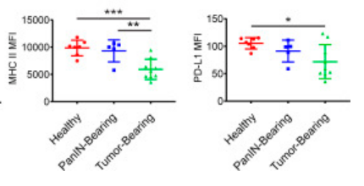
Defects in cDC1 KPC mice are early, progressive, and systemic
cDC1 by flow = CD45+ CD64- Lin- MHC II+ CD11c+ XCR1+
cDC1
CD40
CD80
CD86
PD-L1
MHC Class II
Lin et al, J. Exp. Med., 2020

Slide 12
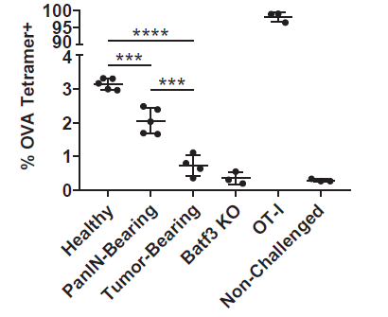
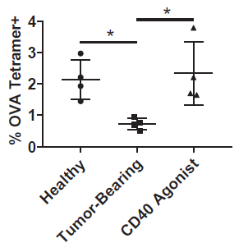
cDC1 dysfunction in vivo in KPC mice – rescued by CD40 mAb
Mice vaccinated with heated killed KPC-OVA tumor cells
Same result with OVA protein + CpG vaccination
Loss of phenotype in CD40 KO mice
Loss of phenotype in BATF3 KO mice
Lin et al, J. Exp. Med., 2020

Slide 13
CD40 as a distinct and alternative pathway for bridging DC activation and adaptive immunity
Elucidation of pathogen-associated and damage-associated molecular patterns (PAMPs and DAMPs) revolutionized our understanding of mechanisms by which activation of innate immunity converts to the triggering of robust adaptive responses
  Ligands connect DCs/myeloid cells with B and T cells that respond with memory to insults from invasive pathogens or damaged tissue
  Other than TLR7, there has been limited success in the IO cancer clinic
CD40 represents an alternative pathway for bridging DC activation and adaptive immunity
  Member of the TNF superfamily of receptors
  Expressed by DCs, myeloid cells, and B cells for which ligation results in cellular activation
Activated by CD40L primarily expressed on CD4⁺ helper T cells, CD40 signaling enables DC licensing and maturation – agonist αCD40 mAb mimic CD40L in vivo
  Based on experiments with KO or mutant mice, we found that signaling via TLRs, the inflammasome, STING, or type I IFN receptors was not required for the efficacy of αCD40 and chemotherapy (Byrne et al, Cell Reports, 2016; Morrison et al, PNAS 2020)

Slide 14
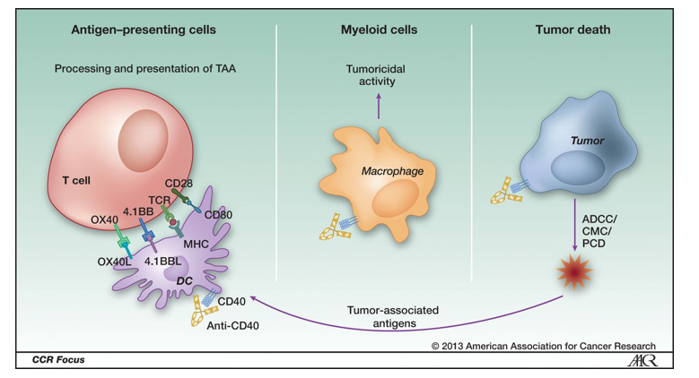
Agonist CD40 mAb: mechanisms
Vonderheide and Glennie, CCR, 2013

Slide 15
Approaches to CD40 activation in patients
Multiple formulations – none is clearly best!
  Agonist antibodies
  Engineered antibodies
  Crosslink dependent
  Crosslink independent
  Bispecific (other agonist, DC targeting)
  Recombinant CD40L
  Highly multiplexed rCD40L
  Gene therapy
  Other
Pharmacological challenges
  Agonists are hard!
  Dose (MBD is not MTD)
  Schedule
  Route of administration
  Isotype selection
  Broad expression of CD40
  Large pharmacological sink in vivo
  WHAT IS THE BEST COMBINATION?
Bullock, Cell Mol Immunol, 2022
Vonderheide, Annu Rev Med, 2020
Remer et al, Curr Top Microbiol Immunol, 2017
Li et al, Science, 2011
Beatty, et al, Science 2011
Melief, Immunity, 2008
Schultze et al, Trends Immunol, 2004
Alexandroff et al, Mol Immunol, 2000
…..And so many more over 25 years

Slide 16
Clinical experience with agonist CD40 mAb
Safety and toxicity (i.v.)
  Transient grade 1-2 cytokine release syndrome on day of infusion, never requires steroids
  Transient grade 1-3 elevations in LFTs at 24-72 hrs after infusion
  Transient thrombocytopenia
  No excess thrombotic events
  Minimal autoimmune breakthrough events such as colitis, thyroiditis, hypophysitis, or pneumonitis
Pharmacodynamic effects
  Transient partial depletion of peripheral B cells
  Upregulation of activation markers on APC in circulation
  Dose-dependent but uniformly observed across patients
Pharmacokinetics
  Short serum half-life
Clinical tumor responses
  Modest single-agent response rate; better with chemotherapy
  No sense of which patients respond
Vonderheide, Ann Rev Med, 2020

Slide 17
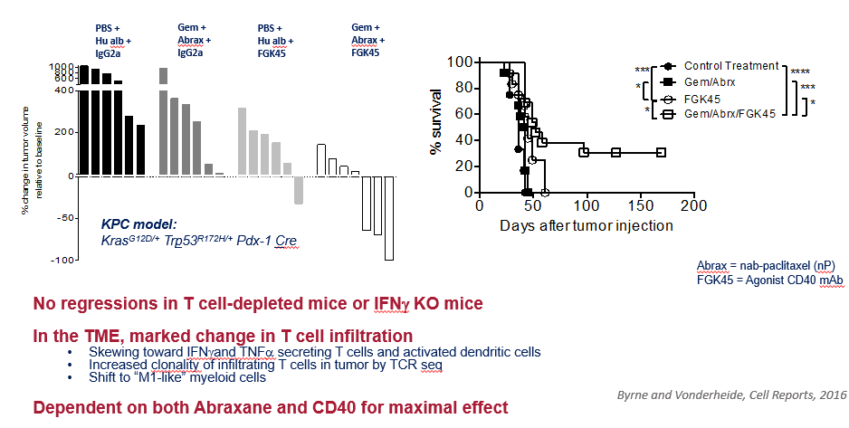
‘Vaccine’ effect of agonist CD40 mAb and chemotherapy

Slide 18
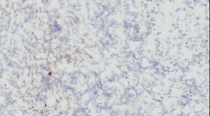
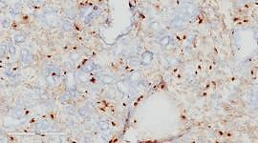
CD40 mAb and chemo sensitize tumors to checkpoint blockade
KPC mouse model of pancreas cancer
(no classically defined neo epitopes)
PD-1, CTLA4, or both
No tumor
response
CD8 IHC
Treatment with gemcitabine,
nab-paclitaxel, agonist CD40
PD-1, CTLA4, or both
Regression
Improved Survival
Cures
(T cell and BATF dep)
Winograd et al, Cancer Immunol Res, 2015; Byrne and Vonderheide, Cell Reports, 2016

Slide 19
Phase 1 study of neoadjuvant/adjuvant CD40 mAb with gemcitabine/nab-paclitaxel in resectable pancreatic cancer
selicrelumab* – Day 3
NCT02588443
Both Arms
Arm
I
IND 126456
Four cycles of adjuvant chemoimmunoRx
  Day 1: Gem/NP
  Day 3: selicrelumab
  Day 8: Gem/NP
  Day 15: Gem/NP
Endpoints
Safety and feasibility
DFS & OS
Immune biomarkers
2 weeks
Surgery
3-12 weeks
Arm II
Gem/NP – Day 1 selicrelumab – Day 3
Study Teams
Penn (O’Hara), Hopkins (Laheru), U Washington (Chiorean), Case (Bajor)
IND Sponsor: Vonderheide
* formerly known as RO7009789 and CP-870,893, fully human IgG2 agonist
SU2C-Lustgarten; PanCan; NCI CITN

Slide 20
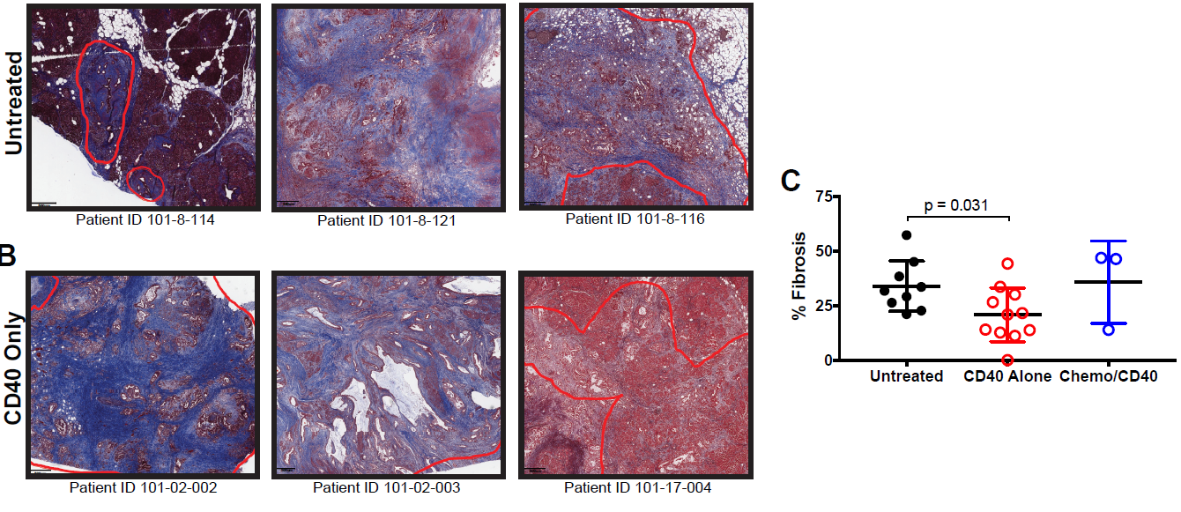
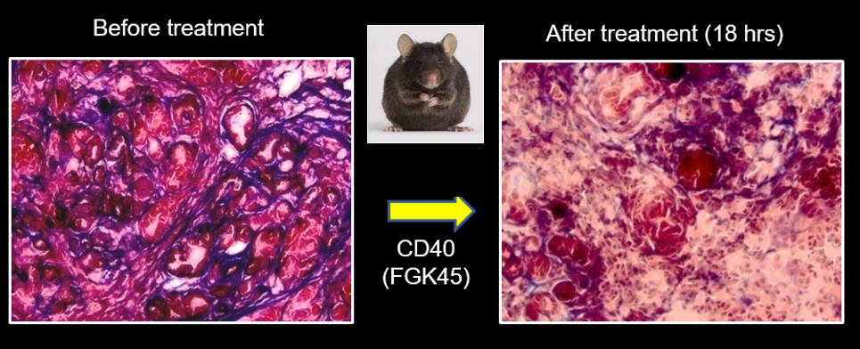
Involution of tumor stroma after selicrelumab
Beatty et al, Science, 2011
Byrne et al, Clin Can Res, 2021

Slide 21
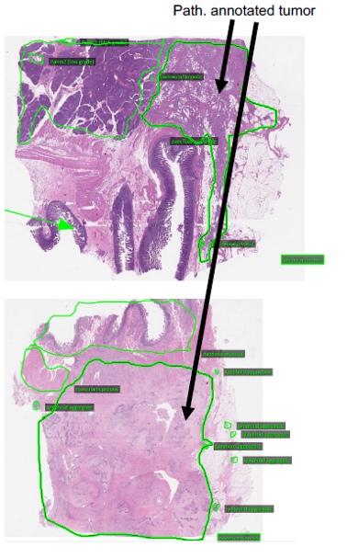
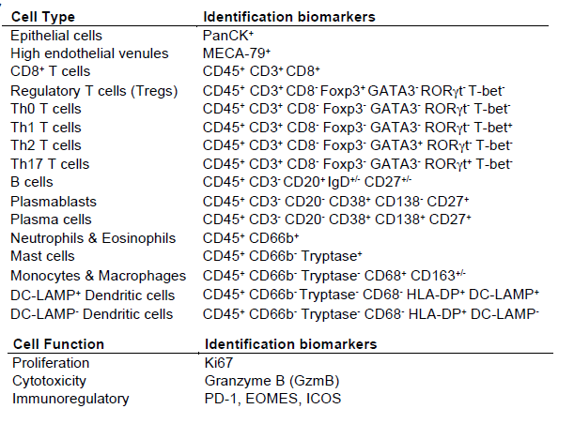
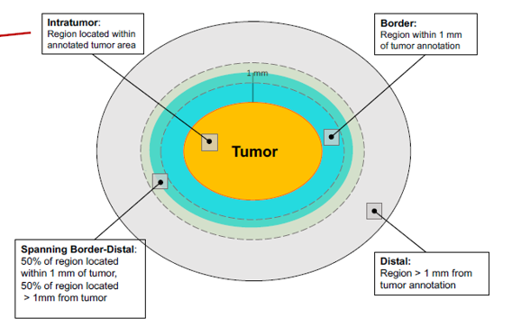
Multiplex IHC on resected human PDAC
IHC
Image Cytometry
Tsujikawa T et al, Cell Reports, 2017
Liudahl S, et al, Cancer Discovery, 2021 – used to develop PDAC atlas

Slide 22
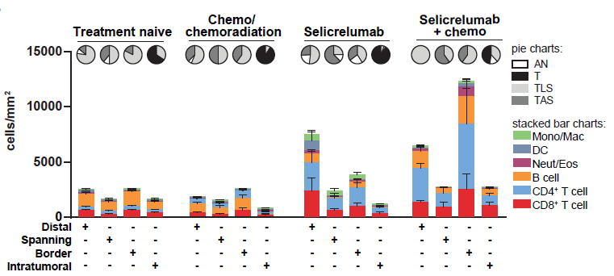
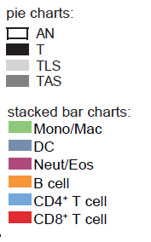
Immune cell distribution in TME and impact of treatment
N=104
N=13
N=8
N=3
From PDAC atlas
From CITN11-01 trial
Byrne et al, Clin Can Res, 2021

Slide 23
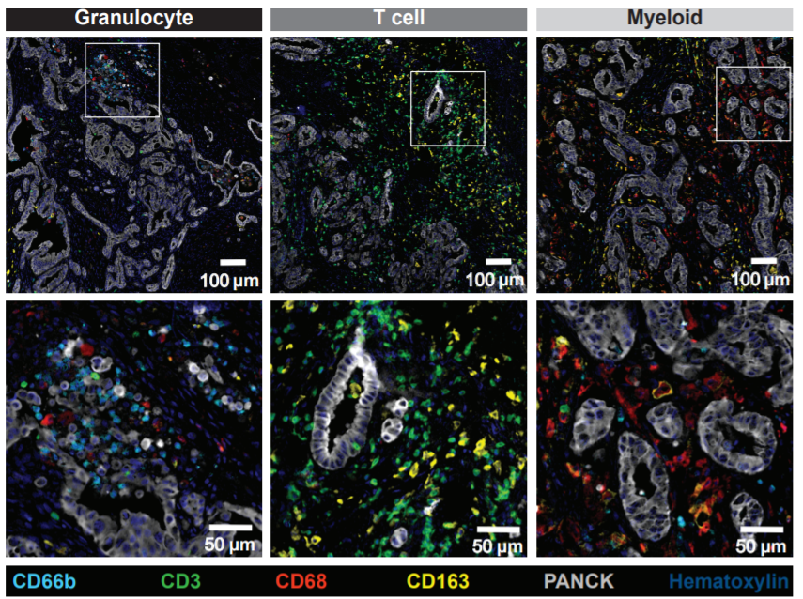
Three patterns of immune infiltration in pancreatic cancer

Slide 24
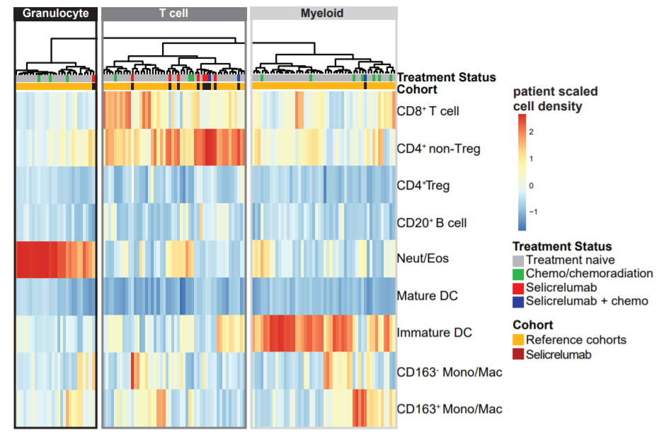
Selicrelumab associated with T cell-rich tumors
Chance of being T cell-rich
Untreated 37% (38/104)
Chemo/chemorads 23% (3/13)
Selicrelumab 82% (9/11)
Only 1 selicrelumab-treated
tumor was myeloid rich
*
**
Byrne et al, Clin Can Res, 2021

Slide 25
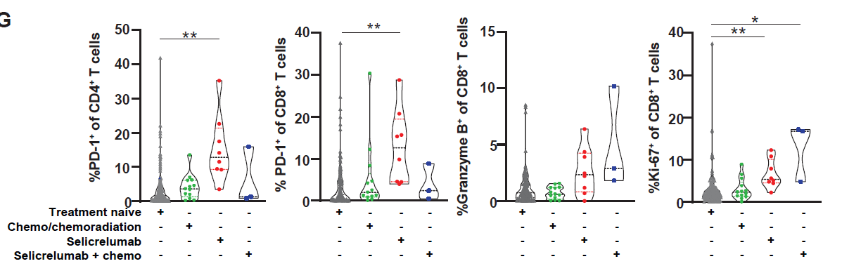
Activation and proliferation of intratumoral T cells

Slide 26
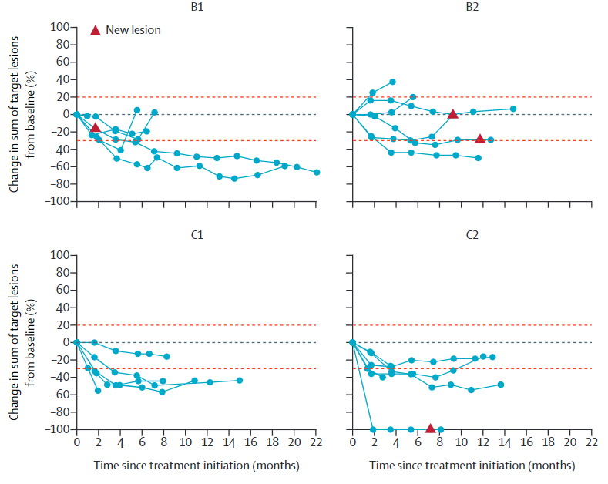
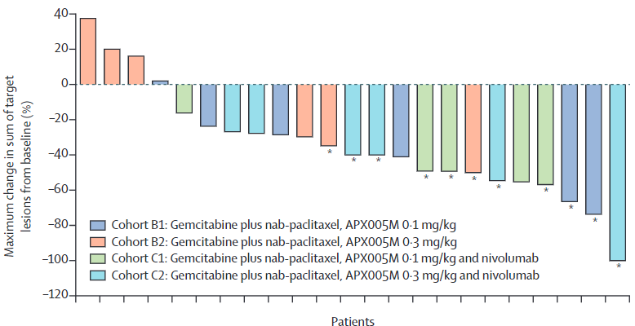
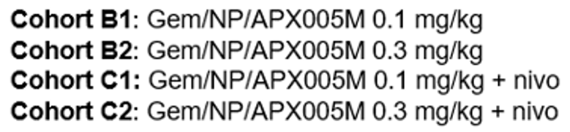
PRINCE: Gem/NP +/- CD40 +/- PD-1 for patients with first-line metastatic PDAC
IND Sponsor: Parker Institute
Overall PI: Vonderheide
Penn (O’Hara), MSK (O’Reilly),
MDACC (Varadhachary/Wolff), UCLA (Wainberg),
UCSF (Ko), Stanford (Fisher), DFCI (Rahma)
Collaboration: CRI, Apexigen, BMS
NCT03214250
Phase Ib/Dose Escalation
Enrollment completed
-- One cycle --
D1 D3 D8 D15 D28
Gem
NP
APX
005M
Gem
NP
Gem
NP
Nivo
Nivo
All drugs i.v.; APX005M = sotigalimab
Filbert et al, CII, 2021
O’Hara et al, Lancet Oncology, 2021

Slide 27
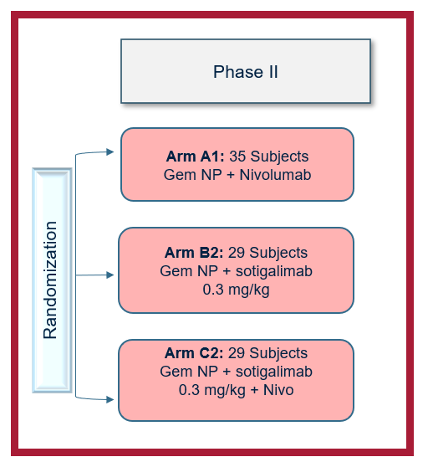
IND Sponsor: Parker Institute
Overall PI: Vonderheide
Penn (O’Hara), MSKCC (O’Reilly),
MDACC (Wolff), UCLA (Wainberg),
UCSF (Ko), Stanford (Fisher), DFCI (Rahma)
Collaboration: Apexigen, BMS, CRI
PRINCE: Gem/NP +/- CD40 +/- PD-1 for patients with first-line metastatic PDAC
Baseline and serial biosamples:
Blood and Tumor
Translational suite
Flow, CyTOF, RNAseq,
DNAseq, IF, proteomics
microbiome
Enrollment completed
N=105
Primary Endpoint
1 year OS
c/w historical 1yr OS 35%
NCT03214250
Machine learning to identify biosignatures of benefit, per arm

Slide 28
PRINCE Phase II results so far
105 patients evaluated for primary endpoint: 1 year OS c/w historical Gem/NP of 35%
  Gem/NP/nivo 57.7%, p=0.006
  Gem/NP/sotigalimab 48.1%, p=0.062
  Gem/NP/nivo/sotigalimab 41.3%, p=0.233
Multi-omic biomarker analysis
  Prelim: Distinct, arm-specific circulating and tumor biosignatures correlated with overall survival
  Results permit trial design based on biomarker-driven patient enrichment
Padron et al, in review
Accepted for presentation at ASCO 2022

Slide 29




Revolution platform study (1L mpDAC)
1L Metastatic PDAC
Reinvigorate T Cell Activation
Cohort A: Anti-PD-1 + Anti-CTLA4 + Chemo Combination
Sample Size 15/cohort, with ability to expand
Autophagy Inhibition-Immune Activation
Cohort B: Anti-CTLA4 + HCQ + Chemo Combination
In development
Cohort C: leveraging PRINCE and above cohorts.
Baseline and on-treatment tumor biopsies, stool collection and peripheral blood collection (including at PD)
Ongoing monitoring of safety, clinical activity, and biomarkers to guide cohort expansion
PRIMARY ENDPOINT:
Safety and feasibility of combination
KEY SECONDARY ENDPOINTS:
OS, PFS, ORR, DOR
BIOMARKER ANALYSES:
Multi-omic, multiparameter analysis of tissue, blood and stool
Customized by cohort
EXPANSION CRITERIA:
Acceptable safety profile
≥5/15 responses (RECIST 1.1)
Compelling biomarker observations
29 | CONFIDENTIAL

Slide 30
Keynote Provocateur ☺
Agonists can prime, CD40 is one way.
Precision medicine may be possible from circulating immune status, not just DNA or RNA sequence of the tumor
Assuming early detection and risk assessment will be possible, we now need to find means of interception against PanIn – ‘immuno-interception’?
Neo-epitopes seem unlikely targets in PDAC except for mutant Kras

Slide 31
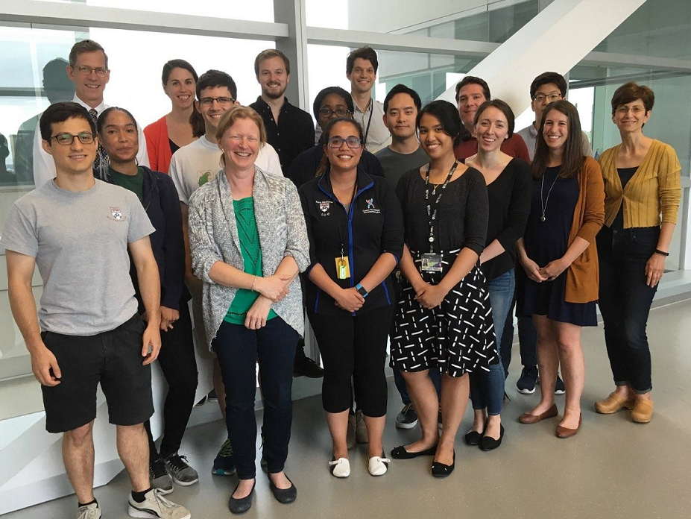
Vonderheide Lab, Penn’s Abramson Cancer Center
Notes:
31

Slide 32
Acknowledgments
Vonderheide Lab Penn collaborators Funding
Katelyn Byrne Mark O’Hara SU2C-Lustgarten
Alex Morrison* Beth Furth Parker Inst. Cancer Immunotherapy
Austin Huffman* Rosemarie Mick CRI
Andrew Rech* Jenny Zhang P01 CA210944
Jeffrey Lin John Wherry R01 CA229803
Lee Richman* Ben Stanger P30 CA016520
Mark Diamond SU2C team BCRF
Sam Kim Lisa Coussens, Courtney Betts Basser Center for BRCA
Nune Markosyan Liz Jaffee, David Bajor NCI CITN
Adham Bear Dan Laheru, Gabi Chiorean
Rina Kim Brian Wolpin
Rina Sor PRINCE team
Noah Cheng Parker Central team (Padron, Mauer, Fairchild, Cabanski, LaValle, Lyman)
Elizabeth Quinones CRI, BMS, Apexigen
Site PIs/teams (Ko, Fisher, O’Hara, O’Reilly, Rama, Wainburg, Wolff)
*former

Slide 33
Thank you!

